Slide 1
Chapter 18
Domain Name
System
(DNS)

Slide 2
CONTENTS
NAME SPACE
DOMAIN NAME SPACE
DISTRIBUTION OF NAME SPACE
DNS IN THE INTERNET
RESOLUTION
DNS MESSAGES
TYPES OF RECORDS
COMPRESSION
EXAMPLES
DDNS
ENCAPSULATION

Slide 3
18.1
NAME SPACE

Slide 4
18.2
DOMAIN
NAME
SPACE

Slide 5
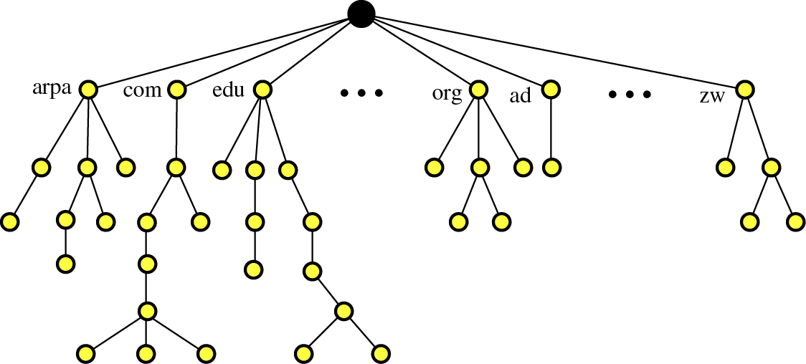
Figure 18-1
Domain name space

Slide 6
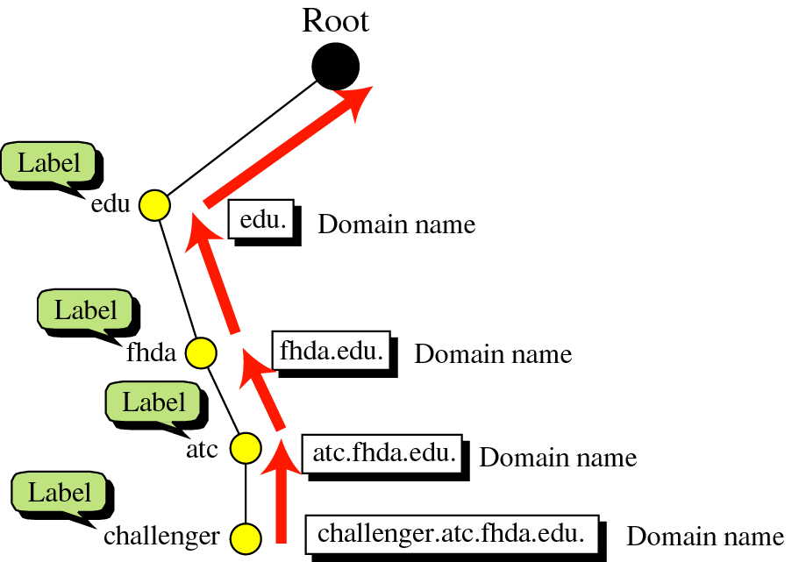
Figure 18-2
Domain names
and labels

Slide 7

Figure 18-3
FQDN and PQDN

Slide 8
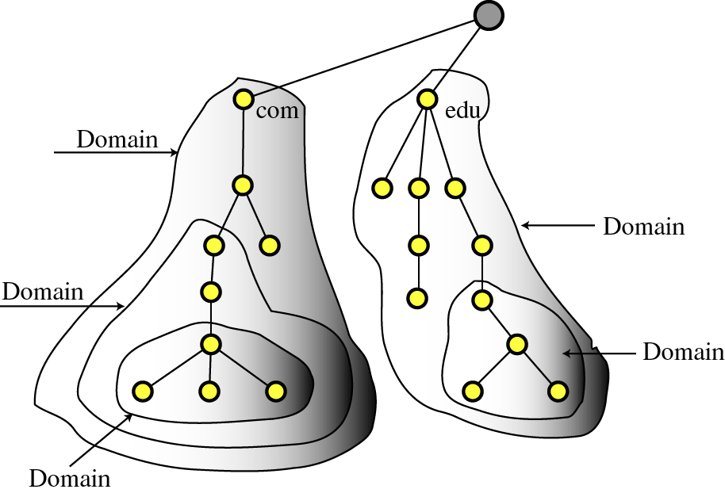
Figure 18-4
Domains

Slide 9
18.3
DISTRIBUTION
OF
NAME SPACE

Slide 10
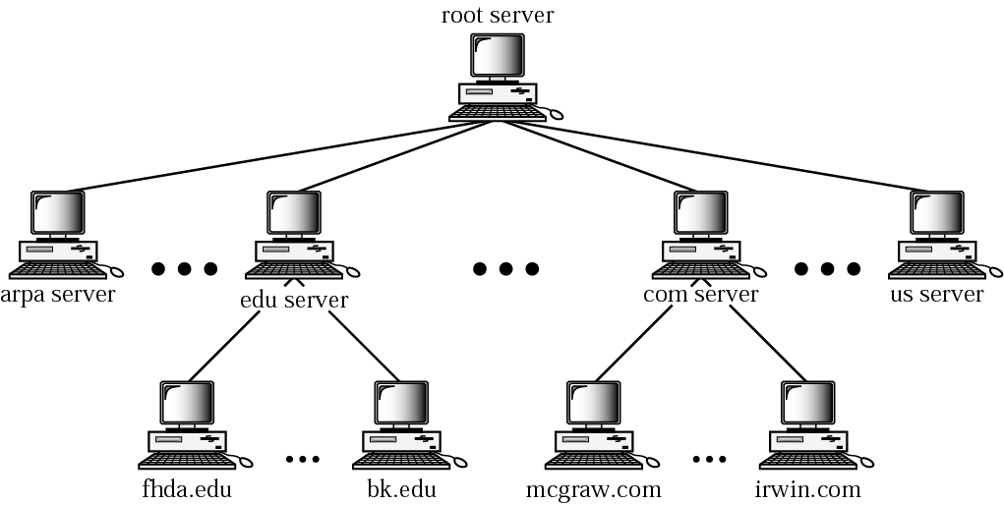
Figure 18-5
Hierarchy of name servers

Slide 11
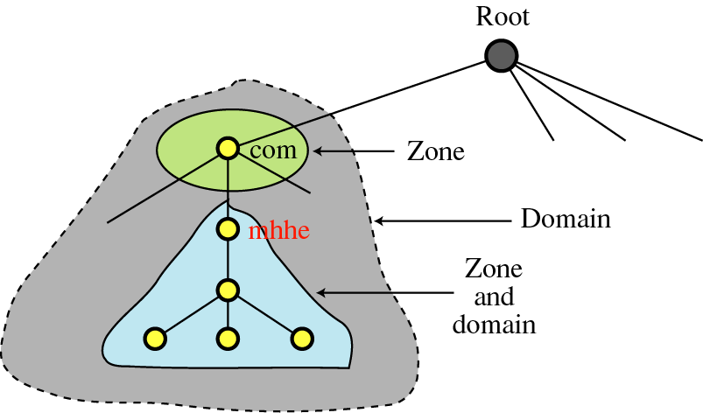
Figure 18-6
Zones and domains

Slide 12

A primary server loads all information from
the disk file; the secondary server loads
all information from the the primary server.
When the primary downloads information
from the secondary, it is called
zone transfer.

Slide 13
18.4
DNS
IN THE
INTERNET

Slide 14
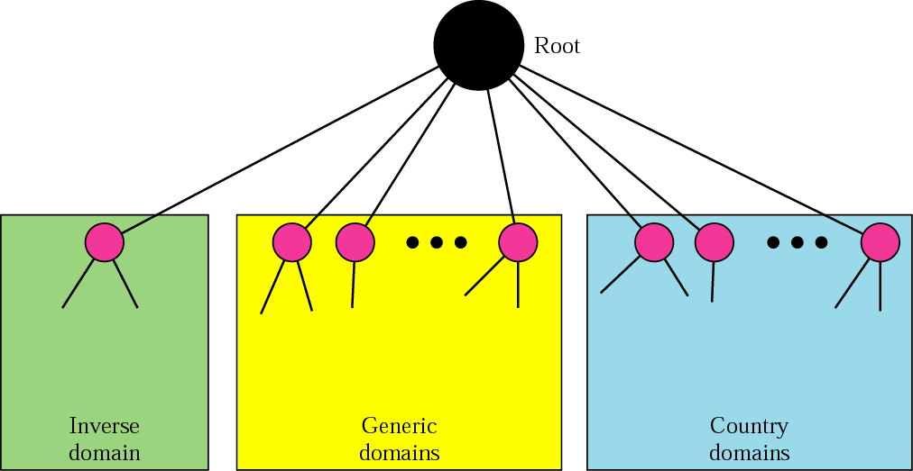
Figure 18-7
DNS in the Internet

Slide 15
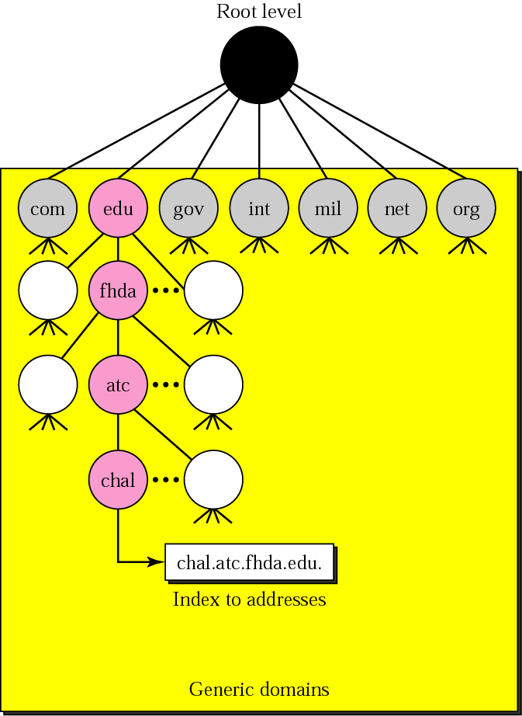
Figure 18-8
Generic domains

Slide 16
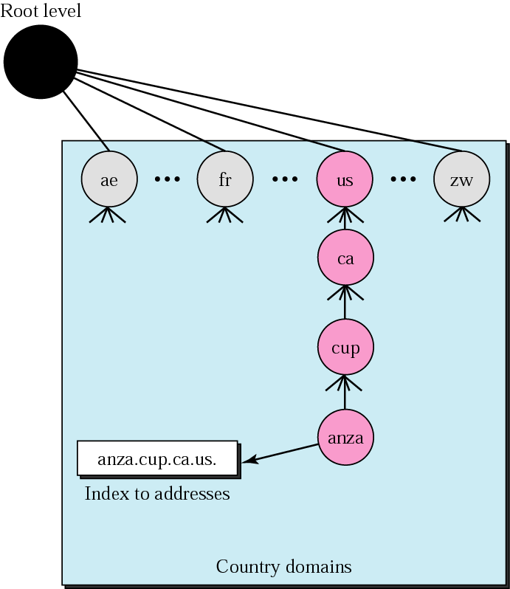
Figure 18-9
Country domains

Slide 17
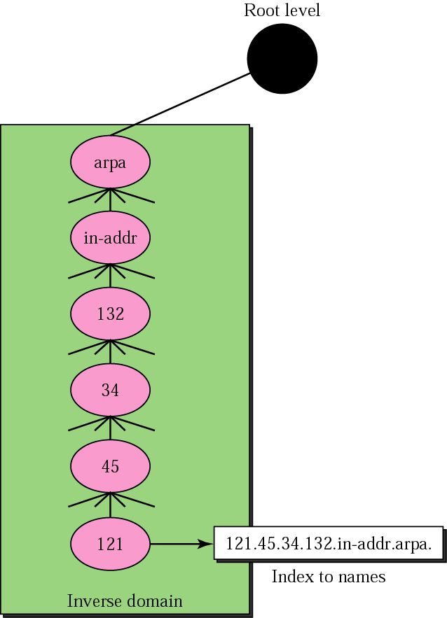
Figure 18-10
Inverse domain

Slide 18
18.5
RESOLUTION

Slide 19
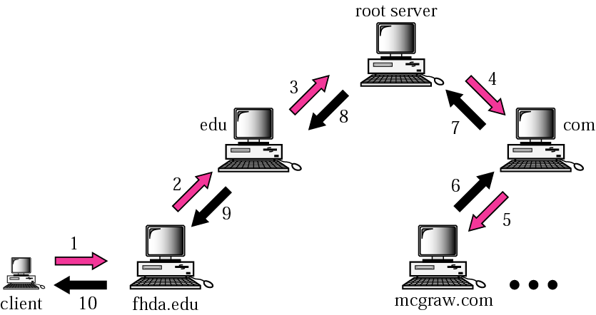
Figure 18-11
Recursive resolution

Slide 20
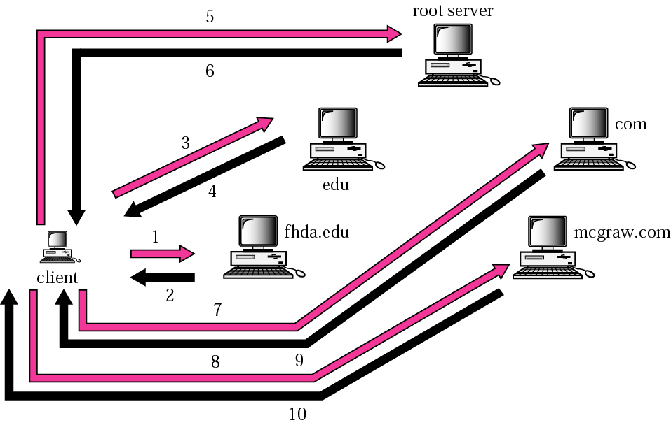
Figure 18-12
Iterative resolution

Slide 21
18.6
DNS
MESSAGES

Slide 22
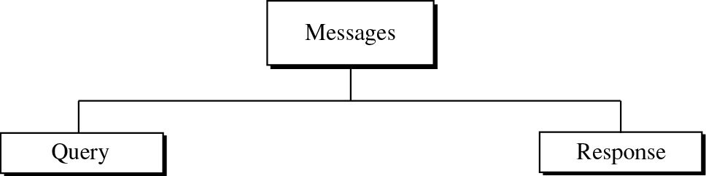
Figure 18-13
DNS messages

Slide 23
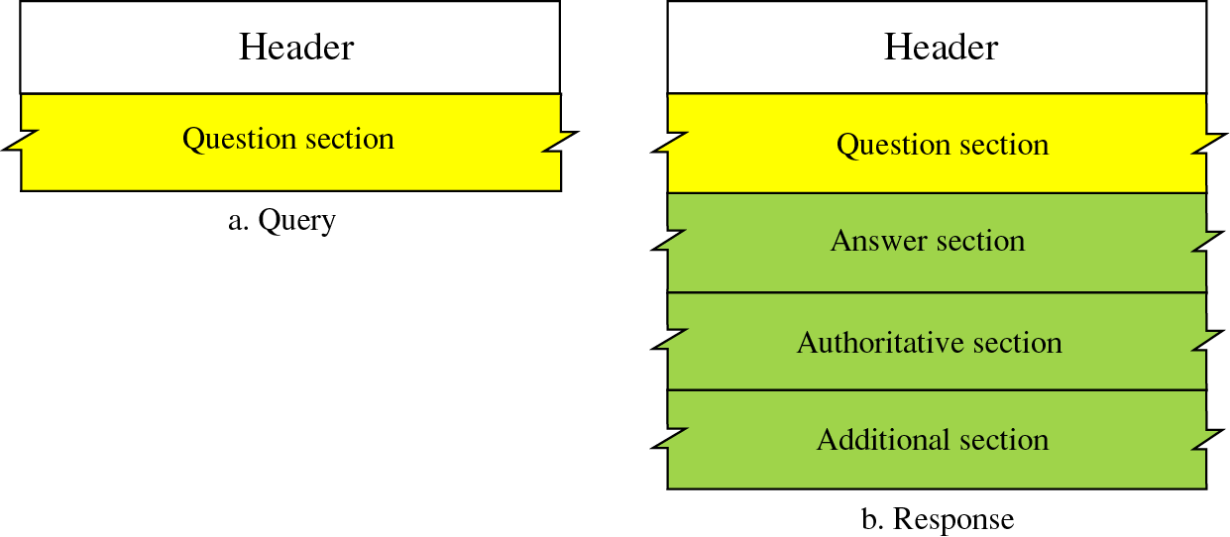
Figure 18-14
Query and response messages

Slide 24
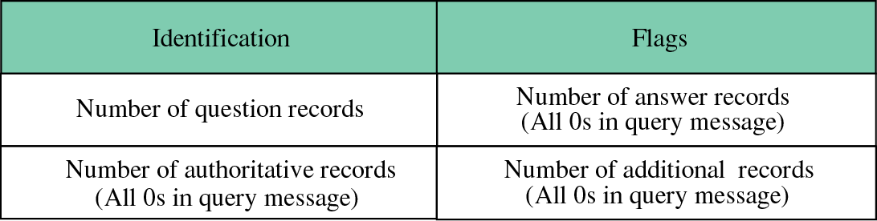
Figure 18-15
Header format

Slide 25
Figure 18-16
Flags fields
QR: Query/Response
OpCode: 0 standard, 1 inverse, 2 server status
AA: Authoritative
TC: Truncated
RD: Recursion Desired
RA: Recursion Available
rCode: Status of the error

Slide 26
18.7
TYPES
OF
RECORDS

Slide 27

Figure 18-17
Question record format

Slide 28
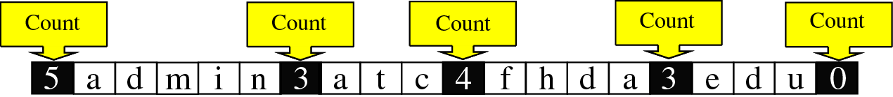
Figure 18-18
Query name format
admin.atc.fhda.edu.

Slide 29
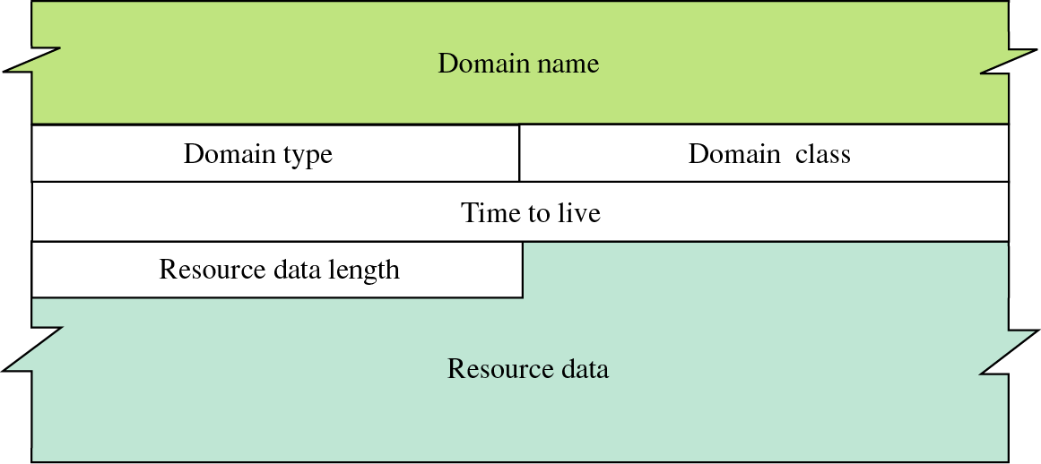
Figure 18-19
Resource record format

Slide 30
18.8
COMPRESSION

Slide 31
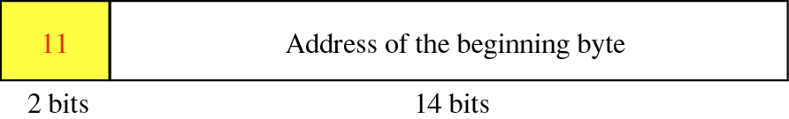
Figure 18-20
Format of an offset pointer

Slide 32
18.9
EXAMPLES

Slide 33
Example 1
A resolver sends a query message to a local server to find the IP address for the host “chal.fhda.edu.”. We discuss the query and response messages separately.

Slide 34
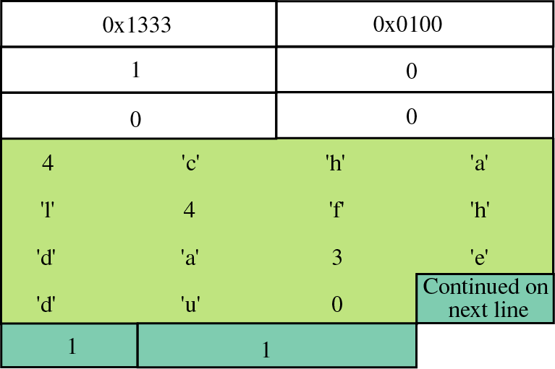
Figure 18-21
Example of a query message

Slide 35
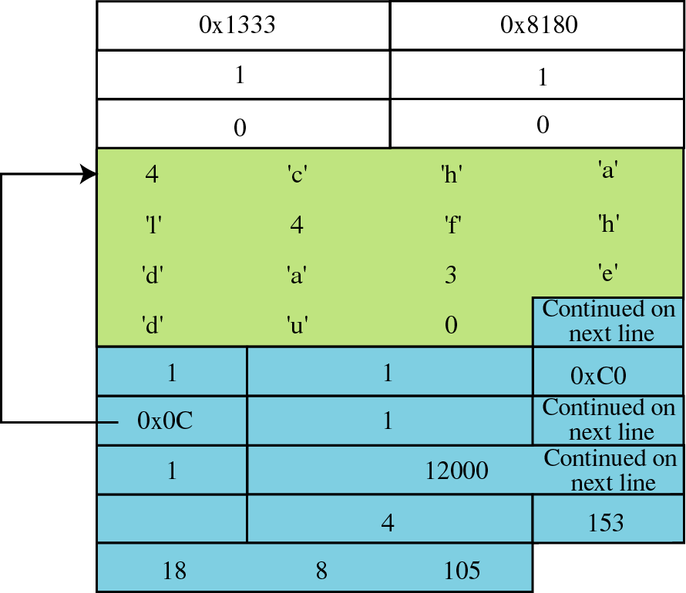
Figure 18-22
Example of a response message

Slide 36
Example 2
An FTP server has received a packet from an FTP client with IP address 153.2.7.9. The FTP server wants to verify that the FTP client is an authorized client.

Slide 37
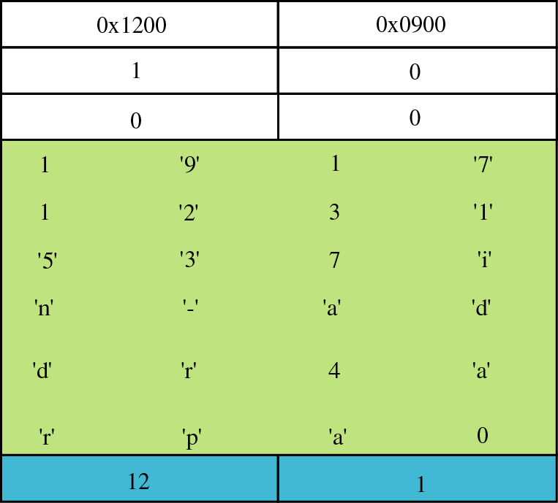
Figure 18-23
Example of inverse query message

Slide 38
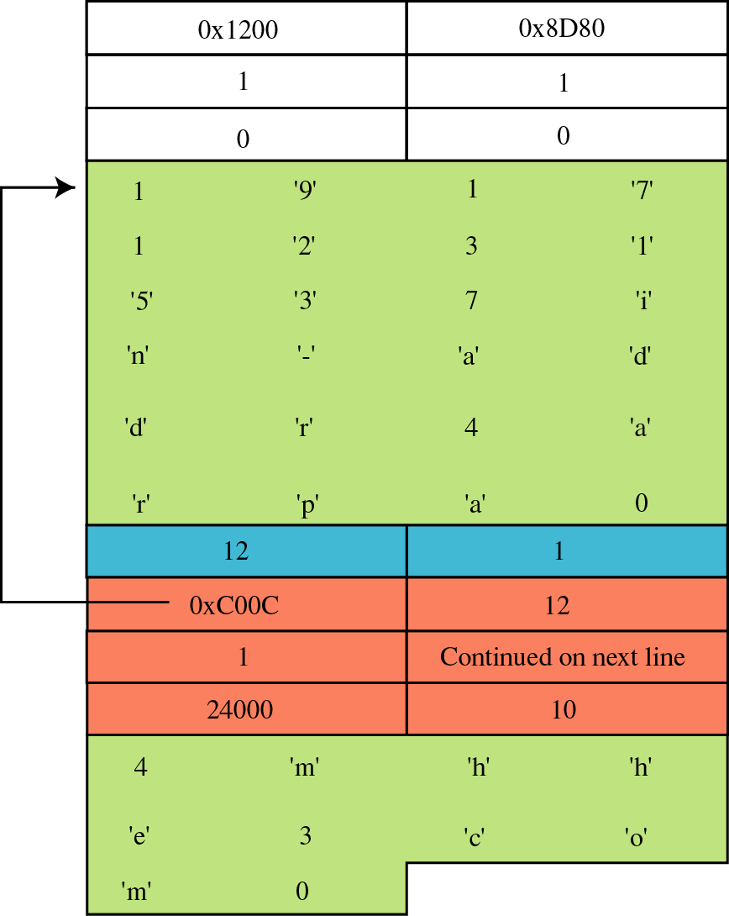
Figure 18-24
Example of inverse
response message

Slide 39
18.10
DDNS

Slide 40
18.11
ENCAPSULATION

Slide 41
DNS can use the services of
UDP or TCP
using the well-known port 53.

